Slide 1

Module 4
Evaluating Model Performance
Notes:
Guidelines
Use section headers to chunk content in your presentation.
Use the same style of section header throughout your presentation.
Keep your title to no more than 2 lines.

Slide 2

Model Performance Evaluation Regression Problems
Notes:
Guidelines
Use a title slide at the beginning of your presentation. There are 9 variations of title slides to choose from.
If you will have a series of slideshows, we recommend using the same style of title slide for each presentation.
Keep your title to no more than 2 lines.
Do not change the font style or font size of the title or subtitle.

Slide 3
Performance Metrics
These are used to measure how good a model is.
Also called evaluation metrics and depend on the task:
Regression Metrics
Classification Metrics
Propensity Metrics

Slide 4

Metrics for Regression
Not the same as “goodness-of-fit”
Focused on how the model predicts new data
Key component is difference between actual and predicted
The difference is called ”error” or ”loss”

Slide 5
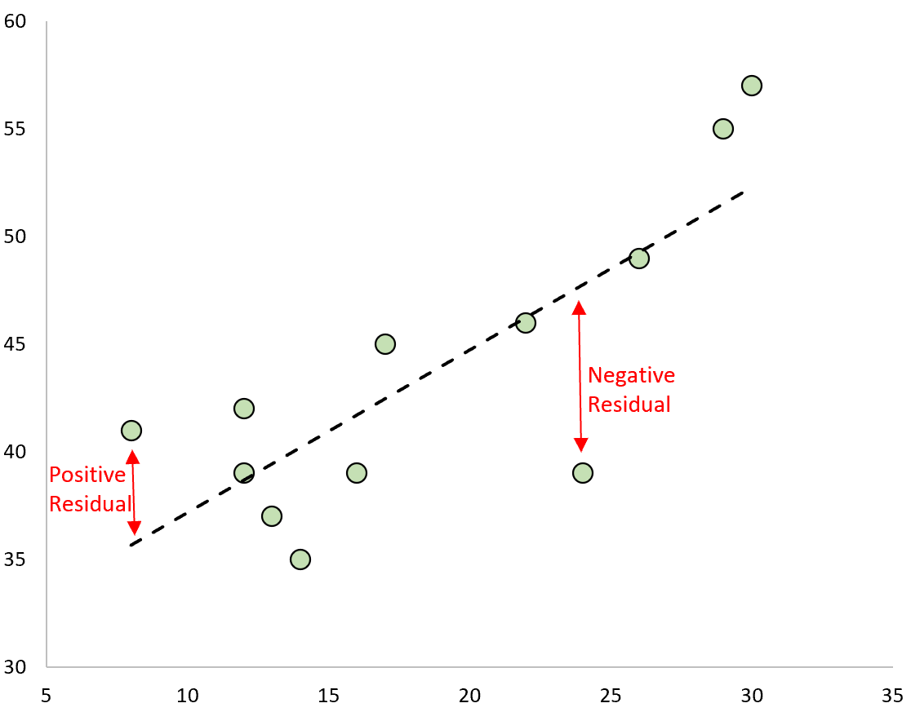
Error (Residual)
This is what regression models attempt to minimize

Slide 6
Error (Residual)
This is what regression models attempt to minimize

Slide 7
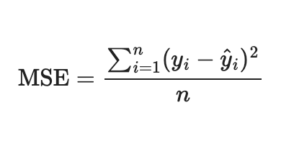

The Mean Squared Error (MSE)
Measures the average squared error
Metric is in squared units of $y$

Slide 8
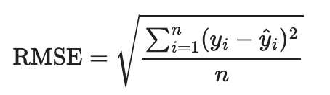

The Root Mean Squared Error (RMSE)
Measures the average error
Metric is in same units of $y$

Slide 9
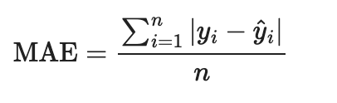

The Mean Absolute Error (MAE)
Measures the average absolute error
Metric is in same units of $y$

Slide 10
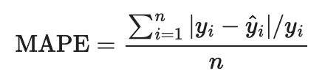
Mean Absolute Percentage Error (MAPE)
Measures the average absolute percentage error
Metric is in fraction or percentage

Slide 11
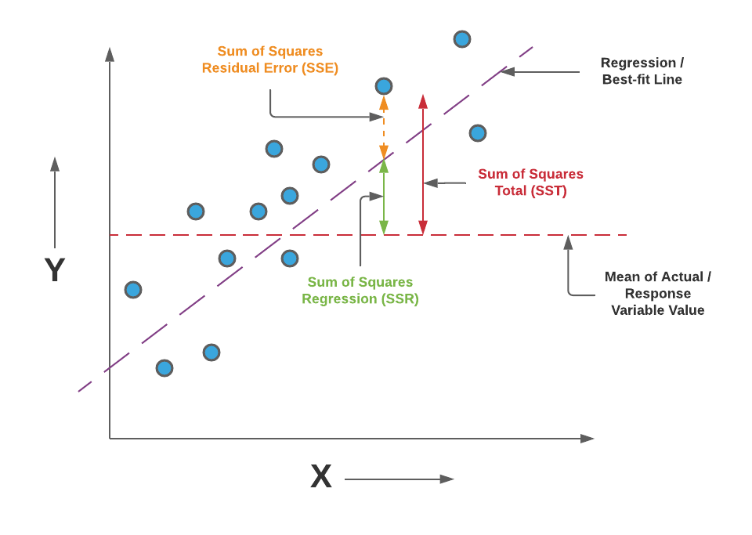
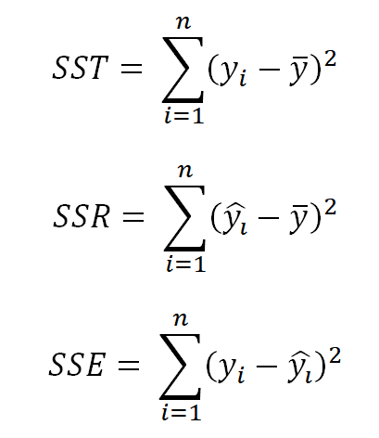
Benchmark Performance
What do we compare against?
How do we know a model is good?
A good model should outperform the benchmark (Naïve) model.

Slide 12
Python
Notes:
Guidelines
Use a title slide at the beginning of your presentation. There are 9 variations of title slides to choose from.
If you will have a series of slideshows, we recommend using the same style of title slide for each presentation.
Keep your title to no more than 2 lines.
Do not change the font style or font size of the title or subtitle.

